Slide 1
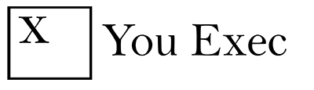
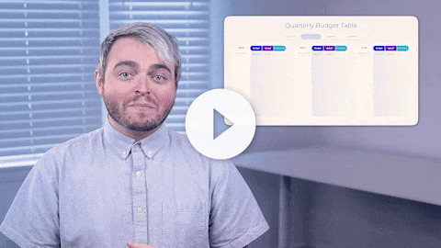
You Exec provides business resources that move your career forward. Access our full library of presentations, spreadsheet models, and business book summaries. We do the work, you take the credit.
Errors & Omissions Liability (E&O): You Exec makes no guarantee that the statements, analysis, projections, estimates, graphs, reports, numbers, and any derivatives sourced from this presentation are free of errors and omissions. You Exec assumes no liability for erroneous outcomes derived from this presentation.
Watch explainer
This video will walk you through the benefits of this framework. Paid members, please log in for a better viewing experience.
Found an error, have suggestions?
Feedback

Slide 2
Annual Budget Table
Jan
Feb
Mar
Apr
May
Jun
Jul
Aug
Sep
Oct
Nov
Dec
Social Media Marketing | 25% | - | 9% | - | 12% | 2% | - | 11% | - | 2% | - | 9%
Content Marketing | 12% | 11% | - | 25% | - | - | - | - | 9% | - | 11% | -
Personalization | - | - | - | 9% | 9 % | - | 11% | 12% | - | - | - | -
Video Advertising | 8 % | 9 % | - | - | - | 9% | - | - | - | 11% | 9 % | 11%
Lead Generation | 12% | - | 11% | 2% | - | 25% | 12% | 25% | - | - | 25 % | -
Marketing Analytics | 9% | - | - | - | 12% | - | 9% | - | 11% | 9% | - | 2%
Mobile Marketing | - | 2% | 12% | 25% | 11% | - | - | - | - | - | - | 2%
Email Marketing | 2% | - | - | 2% | - | 2% | - | 9% | 11% | - | 2% | -

Slide 3
Annual Budget Plan
COMPANY XYZ
Annual Budget
Year 1 – Year 2
Actual
Year 1 – Year 2
Variance
(Budget vs Actual)
Variance
(Budget vs Actual)
Revenue
$50,000
$51,231
$1,231
2.46%
Expenses
$38,000
$39,573
$1,573
4.14%
Net Profit
$12,000
$11,658
$342
2.85%
Revenue
$50,000
$51,231
$1,231
2.46%
General & Administration Expenses
$24,000
$24,808
$808
3.37%

Slide 4
Half-year Budget Table
January
February
March
April
May
June
Social media marketing | $12,670 | $11,087 | - | - | - | $25,600
Content marketing | $83 | - | $11,900 | $13,780 | - | $11,023
Personalization | $250 | $13,780 | - | $92 | $13,900 | -
Video advertising | $14,500 | - | - | - |  | $13,780
Lead generation | - | - | $99,890 | $3,450 | - | -
Marketing analytics | $67,900 | - | - | $120 |  | $43
Mobile marketing | - | - | $9,990 | - | - | -
Email marketing | $13,780 | - | - | $25,780 | - | -
Total: | $10,9183 | $24,867 | $1,21,780 | $43,222 | $13,900 | $50,446

Slide 5
Budget by Quarter
Social media marketing | $12,670 | $11,087 | - | - | Write your Note Here
Content marketing | $83 | - | $11,900 | $13,780 | Write your Note Here
Personalization | $250 | $13,780 | - | $92 | Write your Note Here
Video advertising | $14,500 | - | - | - | Write your Note Here
Lead generation | - | - | $99,890 | $3,450 | Write your Note Here
Marketing analytics | $67,900 | - | - | $120 | Write your Note Here
Mobile marketing | - | - | $9,990 | - | Write your Note Here
Email marketing | $13,780 | - | - | $25,780 | Write your Note Here
Total: | $10,9183 | $24,867 | $1,21,780 | $43,222 | Write your Note Here
20XX
QUARTER 1
QUARTER 2
QUARTER 3
QUARTER 4
NOTES

Slide 6
Budget by Quarter
JANUARY 20XX
FEBRUARY 20XX
MARCH 20XX
Actual
Predicted
Difference
Actual
Predicted
Difference
Actual
Predicted
Difference
Total Income
$195,000
$180,000
$15,000
$155,000
$150,000
$5,000
$172,000
$170,000
$2,000
Total Expense
$150,000
$160,000
$10,000
$140,000
$130,000
-$10,000
$140,000
$160,000
$10,000
Profit/Loss
$45,000
$15,000
$32,000
Income
Sales
$105,000
$100,000
$5,000
$85,000
$90,000
-$5,000
$130,000
$125,000
$5,000
Rental Income
$40,000
$35,000
$5,000
$30,000
$25,000
$5,000
$25,000
$20,000
$5,000

Slide 7
Quarterly Budget Table
QUARTER 1
QUARTER 1
QUARTER 3
QUARTER 4
QUARTER 2
Budget
Difference
Budget
Difference
Budget
Difference
Actual
Actual
Actual
APR
Social media marketing | $10,000 | $8,000 | $2,000
Content marketing | $10,000 | $8,000 | $2,000
Personalization | $10,000 | $8,000 | $2,000
Video advertising | $10,000 | $8,000 | $2,000
Lead generation | $10,000 | $8,000 | $2,000
Marketing analytics | $10,000 | $8,000 | $2,000
Mobile marketing | $10,000 | $8,000 | $2,000
Email marketing | $10,000 | $8,000 | $2,000
Total: | $80,000 | $64,000 | $16,000
MAY
Social media marketing | $10,000 | $8,000 | $2,000
Content marketing | $10,000 | $8,000 | $2,000
Personalization | $10,000 | $8,000 | $2,000
Video advertising | $10,000 | $8,000 | $2,000
Lead generation | $10,000 | $8,000 | $2,000
Marketing analytics | $10,000 | $8,000 | $2,000
Mobile marketing | $10,000 | $8,000 | $2,000
Email marketing | $10,000 | $8,000 | $2,000
Total: | $80,000 | $64,000 | $16,000
JUN
Social media marketing | $10,000 | $8,000 | $2,000
Content marketing | $10,000 | $8,000 | $2,000
Personalization | $10,000 | $8,000 | $2,000
Video advertising | $10,000 | $8,000 | $2,000
Lead generation | $10,000 | $8,000 | $2,000
Marketing analytics | $10,000 | $8,000 | $2,000
Mobile marketing | $10,000 | $8,000 | $2,000
Email marketing | $10,000 | $8,000 | $2,000
Total: | $80,000 | $64,000 | $16,000

Slide 8
August
September
October
November
December
 | Budget | Actual | Difference
Social media marketing | $10,000 | $8,000 | $2,000 | Write your Note here
Content marketing | $10,000 | $8,000 | $2,000 | Write your Note here
Personalization | $10,000 | $8,000 | $2,000 | Write your Note here
Video advertising | $10,000 | $8,000 | $2,000 | Write your Note here
Lead generation | $10,000 | $8,000 | $2,000 | Write your Note here
Marketing analytics | $10,000 | $8,000 | $2,000 | Write your Note here
Mobile marketing | $10,000 | $8,000 | $2,000 | Write your Note here
Email marketing | $10,000 | $8,000 | $2,000 | Write your Note here
Total: | $80,000 | $64,000 | $16,000
Monthly
Budget Table

Slide 9
Budget
Difference
Actual
Operating Revenue | $50,000 | $50,000 | $50,000
Non-Operating Revenue | $50,000 | $50,000 | $50,000
Total Revenue | $1,875,000 | $1,875,000 | $1,875,000
Total Expenses | $1,425,250 | $1,425,250 | $1,425,250
Profit | $449,750 | $449,750 | $449,750
FULL YEAR
Budget
Difference
Actual
Operating Revenue | $50,000 | $50,000 | $50,000
Non-Operating Revenue | $50,000 | $50,000 | $50,000
Total Revenue | $1,875,000 | $1,875,000 | $1,875,000
Total Expenses | $1,425,250 | $1,425,250 | $1,425,250
Profit | $449,750 | $449,750 | $449,750
YEAR TO DATE
Budget
Difference
Actual
Operating Revenue | $50,000 | $50,000 | $50,000
Non-Operating Revenue | $50,000 | $50,000 | $50,000
Total Revenue | $1,875,000 | $1,875,000 | $1,875,000
Total Expenses | $1,425,250 | $1,425,250 | $1,425,250
Profit | $449,750 | $449,750 | $449,750
MONTH

Slide 10


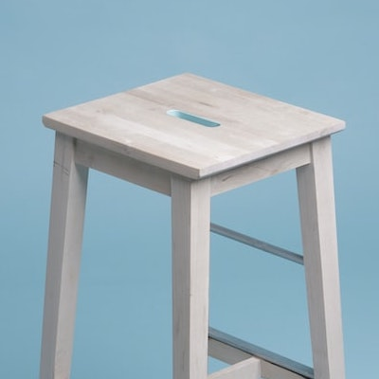
Budget Planning by Costs vs Benefits
Projects
Year 1 Cost
Year 2 Cost
Year 3 Cost
Direct ROI
Benefits
$250,000
$250,000
$250,000
Negative
-$95,000
Less Carbon
Footprint
Project Name
$6,500
$4,000
$4,000
Positive
+$12,000
Improve
Productivity
Project Name
$115,000
$115,000
$115,000
Positive
+$75,000
Business
Opportunities
Project Name

Slide 11
Master Budget Map
Factory Overhead
Cash Budget
SALES BUDGET
Production Budget
Direct Labor
Costs of goods sold budget
Selling expense budget
Admin expected budget
Budgeted balance sheet
Budgeted income statement
Desired Inventory Ending Budget
Direct Material
Capital Budget

Slide 12
Annual Budget Layout
ANNUAL BUDGET
Sales Budget
Production/Purchasing Budget
SG&A
Capex & R&D
Inventory
COGS (Labor, Material, Overhead)
Cash Plan / CF Statement
Income Statement
Balance Sheet

Slide 13
Budget Summary
PHASE 02
PHASE 04
Budget 1 | $500
Budget 2 | $5000
Budget 3 | $18,750
Budget 1 | $500
Budget 2 | $5000
Budget 3 | $18,750
Budget 1 | $500
Budget 2 | $5000
Budget 3 | $18,750
Budget 1 | $500
Budget 2 | $5000
Budget 3 | $18,750
PHASE 01
PHASE 03

Slide 14
Budget Breakdown
Website / Branding / Strategy
Online
Brand Strategy
Rebranding
Blog/content generation
Targeted pages
Search engine optimization
Web design/development
Directories
Social media
Email marketing
Paid search
Virtual events
Public Relations
PR placement
Press releases
Award submissions
Advertising / Promotions
Direct mail
Outdoor ads
Banner ads
Print ads
Mobile ads
Events
Event marketing
Event sponsorship
Organization membership(s)
Tradeshows / exhibitions

Slide 15
Email Marketing
Traditional Marketing
$53,900
$53,900
Social Media (Organic)
$26,950
Social Media (Paid)
SEO & Content Marketing
$80,850
$134,750
Web design & Management
Paid Search
$80,850
$107,800

Slide 16
Target spend
Estimated conversions
Estimated CPA
$50,575
25K
$10.56
Mar 18, 20XX
Estimated spend
18.5K
Target spend
19.0K

Slide 17
Budget Allocation Across Time
Year 1
Year 2
Year 3
Year 4
Marketing technology
Paid media
Labor
Agencies / Services

Slide 18
Budget Breakdown
Project Activities
Budget USD
Percentage
Project activity 1
$1,000
10%
Project activity 2
$1,500
15%
Project activity 3
$1,400
45%
Project activity 4
$5,000
32%
Project activity 5
$800
5%
Project activity 6
$1,000
7%

Slide 19
Projected Budget

Slide 20
Budget VS Actual
95%
97%
98%
99%
100%
100%
86%
92%
79%
64%
64%
56%
45%
40%
30%
33%
27%
27%
27%
28%

Slide 21
Variance Statistics
Budget vs. Actuals: October 20XX
 |  | Base | Negative | Positive
Net Profit - Budget | 27% | 26.5
Raw Material / Packing Material Cost | 8.9% | 26.5 | 0.0 | 8.9
Labor Costs | -2.2% | 33.2 | 2.2 | 0.0
Other Manufacturing Cost | -23.4% | 9.8 | 23.4 | 0.0
Administrative Overheads | 4.6% | 9.8 | 0.0 | 4.6
Selling and Distribution Overheads | -6.6% | 7.8 | 6.6 | 0.0
Net Profit - Actual | 8% | 7.8

Slide 22
Budget Summary
Merit increase
$4,000
$8,000
$4,000 left
Cost of living adjustment
$20,000
$12,000
$8,000 over
!
Market adjustment
$400
$500
$100 left
HR analyst
$3,000
$5,000
$2,000 left
Plant and equipment
$1,000
$3,000
$2,000 left
Promotion
$25,000
$20,000
$5,000 over
!
Consulting & outsourcing
$2,000
$4,000
$2,000 left
Patent and trademark
$2,000
$4,000
$2,000 left
= under budget
= over budget

Slide 23
Budget & Actual (under / over budget)
Marketing
Labor
Supplies
Admin
Actual
Budget:
89.8
14.4
1.7
100
13.2
2.5
87.5
80
41.2
4.4
60
40
21
7.5
20
0
Budget
Variance
Budget
Variance
Budget
Variance
Budget
Variance

Slide 24
Budget Impact Analysis
1 Year
2 Year
3 Year
4 Year
5 Year
200,000
160,000
120,000
80,000
40,000
0
-40,000
-80,000
-120,000
-160,000
-200,000

Slide 25
Budget Impact – Sensitivity Analysis
Sensitivity analysis 5
Sensitivity analysis 2
Sensitivity analysis 1
Sensitivity analysis 3
Sensitivity analysis 4
Sensitivity analysis 6
-50
-40
-30
-20
-10
0
10
20
30
40
50

Slide 26
Budget ROI & Performance
Today
Max 1:1 Post-Purchase
Online Pre-Purchase 1:1
Maximize Pre-Purchase 1:1
Long-Term
Performance driver
Conventional tactics
Shift greater % of CRM budget to 1:1 display advertising
Shift greater % of online media budget to 1:1 display advertising
Shift greater % of CRM budgets to 1:1 messaging
Maximized 1:1 marketing
Enabling media dynamics
Integration of behavioral data with CRM systems become less costly
Continued shift of media mix to digital channels
. Personalization enabled across all digital channels.
Budget allocated 1:1
<1%
~5%
~15%
~30%
$35
$5
ROAS
$30
$80
$10

Slide 27
Licensed Content Amortization
8.1B
Cost of Revenue
Produced Content Amortization
17.3B
4.2B
Other Content Costs
Subscription Revenue
5.1B
29.5B
Marketing Costs
Total Revenue
29.7B
2.5B
Tech & Development
2.3B
Gross Profit
General % Admit Costs
12.4B
1.4B
Operating Profit
Rental Revenue
6.2B
182M
All numbers in US Dollars ($)

Slide 28
Cost 1
10
Cost 2
7.5
Cost 3
0
PRODUCT 01
Cost 4
5
11.5
Cost 5
4.5
25.5
PRODUCT 02
3.5
30.7
Cost 6
2
2.8
xx.x
Cost 7
8
PRODUCT 03
Cost 8
0
Cost 9
2.7
Cost 10
1.2
EXPENSE
ACTIVITY
PRODUCT
TYPE 01
TYPE 02
TYPE 03

Slide 29
Project results before and after new budget plan
Project A had the greatest gains with new budget
74%
74%
PROJECT A
PROJECT A
55%
55%
PROJECT B
PROJECT B
43%
43%
32%
33%
32%
33%
PROJECT C
PROJECT C
11%
11%
Before new budget
After new budget
Before new budget
After new budget

Slide 30
Income
$8,300
Expenses
$550
ACTUAL INCOME
INCOME BUDGET
ACTUAL EXPENSES
EXPENSES BUDGET

Slide 31
Gantt Chart
Resource Allocation
Open and Pending Actions
Project 01
Project 02
Project 03
Project 04
Project 05
Pending…
Issues
Revision
Project Budget
Project Name
Sum of High Risk
Sum of Medium Risk
Sum of Low Risk
Project 01 | 2 | 1 | 5
Project 02 | 3 | 2 | 4
Project 03 | 4 | 3 | 2
Project 04 | 5 | 7 | 6
Project 05 | 3 | 5 | 5
Grand Total
17
18
22

Slide 32
Budget Proposal Template
Project title
Project manager
Start Date
End Date
Est. Budget
Project ABC
John Smith
April 10, 20XX
Dec 20, 20XX
$50,000
Description
Scope
All global IT projects to be added to the tool
Create an in-house PPM to include all Global IT Project
Goals and Objectives
Impact Analysis
All Information Technology projects that require agreement on the Memorandum of Understanding between the Customer and the Service Provider are approved through email. This project was initiated to reduce the manual approvals and create a system to obtain and track the approvals to reduce any discrepancies and loss of data
The total budget for this project is > $1,000,000.00
This project will change one or two existing business processes
This project will not interrupt existing production IT systems
This project is not mission critical
HIGH COMPLEXITY
LOW COMPLEXITY
LOW COMPLEXITY
LOW COMPLEXITY
Classification
Recommended documentation
HIGH COMPLEXITY
LOW COMPLEXITY
MEDIUM COMPLEXITY
HIGH COMPLEXITY
Classify the project using the highest complexity rating of any of the impact analysis sections above
Project Proposal
Resource Plan
Security & Impact Analysis
Budget Plan

Slide 33
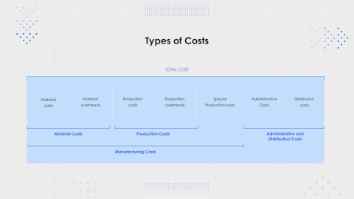

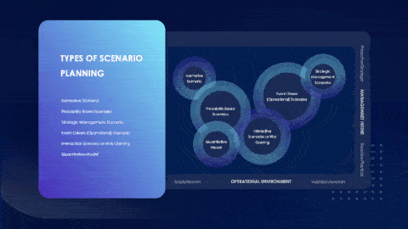
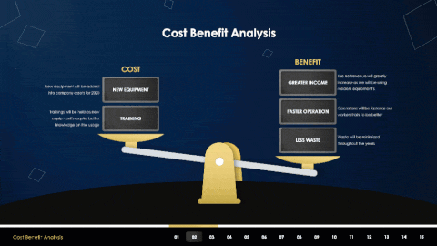
Related
The following resources are related to this framework and can save you hours of work.
If you’re a free or paid member, log into You Exec first for a better download experience.
Cost Management
Cost Optimization
Scenario Planning
Cost-Benefit Analysis

